Slide 1

BioRubeBot
CS452 – Senior Software Engineering Capstone Project
Fall 2015

Slide 2
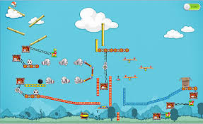
The customer’s problem…
Dr. Cline’s vision is to create a physics based game that simulates the KMAP Signaling in a cell. She wants the user to learn while playing the game. The idea came from the illustrated game below, “The Incredible Machine”, which uses physics to simulate real world movements.

Slide 3
Challenge to the team…
The project was delivered to our team after 2 semesters of development with many programming challenges yet to solve.
The program needed to be more dynamic than the state it was in at the beginning of the semester.
Learning Unity in a short amount of time in order to work on the project.
Understanding the biology behind the project.

Slide 4
Proposed solution
Replace static assigned values with dynamic code to handle various situations.
Write the code for the Kinase and Transcription Regulator objects.
The Kinase and Transcription Regulator has to interact with each other and with objects already existing in the program.
Add code to snap Receptor and Nuclear Pore to Cell Membrane and Cell Nucleus.
Enhance and add functionality to ATP algorithms.
Refactor previous code to interact with the new objects.
Create a new tutorial, both front end and back end.

Slide 5

Details
Kinase object
The Kinase object has to merge with the G-Protein object after the G-Protein has a phosphate deposited on it:
Using the G-Protein to control the merge process was the key.
The two objects then have to agree on a meeting location, then the objects randomly move to the meeting place and with timeouts predetermined the meeting may or may not happen which lends to the random nature of the way the objects should behave.
The merged G-Protein and Kinase had to act as one object while merged:
The two objects move as one once they are merged, simply applying the same forces to each object at the same time.
Separation of the two objects:
After a predetermined amount of time the objects separate and again randomly move as individual objects, now the Kinase is ready for the Transcription Regulator merge.
At the time of separation the Kinase transforms into its 2nd stage form.

Slide 6

Details
Transcription Regulator object
The Transcription Regulator object has to merge with the Kinase object after the Kinase has transformed into its 2nd stage:
Using the Kinase to control the merge process was the key.
The two objects then have to agree on a meeting location, then the objects randomly move to the meeting place and with timeouts predetermined the meeting may or may not happen which lends to the random nature of the way the objects should behave.
The merged Transcription Regulator and Kinase had to act as one object while merged:
The two objects move as one once they are merged, simply applying the same forces to each object at the same time.
Separation of the two objects:
After a phosphate has been deposited on the Transcription Regulator the objects will separate and the Transcription Regulator is ready to enter the Nucleus.

Slide 7

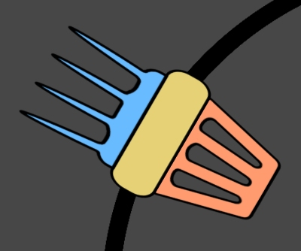
Details
Snap and Rotate Functionality for the Receptor and Nuclear Pore Complex
Originally, the Receptor was a very static object. It could only be placed at the top of the Cell Membrane and still have its intended functionality.
An algorithm was needed that would rotate the Receptor dynamically as the user moved it around the circumference of the Cell Membrane.
It was also determined that the user needed aid to properly place the Receptor along the Cell Membrane so an algorithm was created to snap the Receptor to the Membrane once it was close enough.
Issues:
The ATP code would not allow it to properly dock with the Receptor when the Receptor was rotated.
If the ATP was on the opposite side of the Nucleus, it would get stuck trying to get to the Receptor.

Slide 8
Details
Solution(s) to ATP issues
New Tracking algorithm:
ATP now tracks directly to the proposed receptor leg.
ATP now rotates to the angle needed to properly drop off the phosphate.
Only one ATP tracks to a given receptor leg.
The tracking algorithm now uses raycasting to determine if the Nucleus is in the way and plots a course around the Nucleus.
The tracking algorithm also reuses the same code to find and dock with a Kinase/T-Regulator pair using a tracking class.
New randomized movement:
ATP now has fluid, truly random movement when not tracking an object.
Variable direction and speed with smooth rotation.

Slide 9
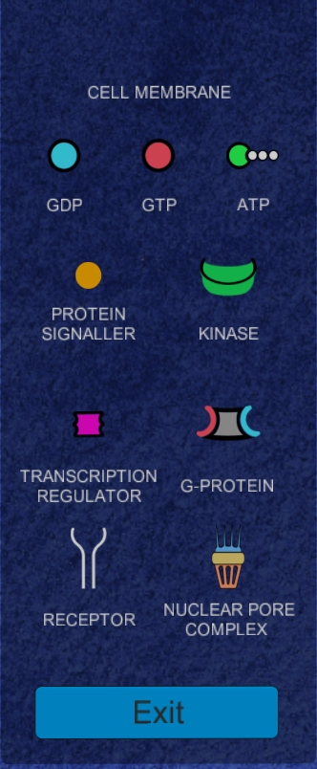
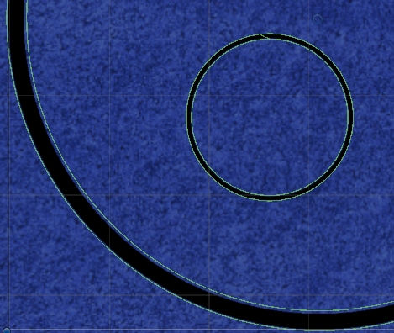
Details
Other Solutions
Nuclear Pore Complex object was created and added to the menu.
New algorithm to draw inner and outer circular colliders for both the Cell Membrane and Nucleus.
Protein signaler no longer breaks through the Cell Membrane.
Receptor and Protein Signaller size increased.
Only one Cell Membrane is allowed to be placed by the user.
Excess code and objects were removed.

Slide 10
Results
The game feels more alive
The source code is easier to follow than what was given to our group
The source code has been refactored to be more dynamic
The source code has been refactored eliminating much of the copy and paste code that existed and now uses a class with static methods to handle repeating functionality

Slide 11
Demonstration
Previous Version:
Tutorial
Receptor
ATP
G-Protein
Kinase
Transcription Regulator
Latest Version:
Tutorial
Receptor
ATP
G-Protein
Kinase
Transcription Regulator and Nuclear Pore

Slide 12
Conclusions
BioRubeBot now is ready to take to the next level
More levels
Game like features
Incorporating more dynamic functionality
It was not always easy but we feel we are turning over a much improved project than the one we inherited which was part of our goal as well as meeting the project requirements

Slide 13
Next steps
Adding more levels
Adding game features like score keeping and user interaction
Further improving the source code and adding functionality
Advice for the group taking over this project:
Use your spare time now to get to know Unity, watch tutorials, play with the project, learn C#: the language used to drive Unity.
Understand the problem – get with Dr. Cline and learn what the project is all about and what the objects are supposed to do.
Enjoy the process, at the end it was a lot of fun and should be for you too!

Slide 14

THANK YOU FOR YOUR TIME
Kevin Means
Jeremy Rogers
Jonathan Dauwen

